Slide 1
Ethernet LANs
Operating Cisco IOS Software

Slide 2
Operating Cisco IOS Software
Using the Cisco SDM
Managing Cisco Devices

Slide 3

Cisco IOS Software
Features to carry the chosen network protocols and functions
Connectivity for high-speed traffic between devices
Security to control access and prohibit unauthorized network use
Scalability to add interfaces and capability as needed for network growth
Reliability to ensure dependable access to networked resources
Notes:
Purpose: This slide introduces Cisco IOS software.
Emphasize: Use this slide for your first introduction of Cisco IOS software to your students. Cisco IOS software is the platform that delivers network services for the network applications. This Cisco IOS software platform extends beyond the routers. Cisco IOS also applies to selected Catalyst switches. Eventually, all Cisco platforms may merge to the Cisco IOS software.
Note: The Catalyst 1900 and 2900xl switch Cisco IOS has a common look and feel like the router’s Cisco IOS. However, the switch Cisco IOS is not 100 percent identical to the router’s Cisco IOS.
Tính năng để thực hiện các giao thức mạng và chọn chức năng
Kết nối giao thông tốc độ cao giữa các thiết bị
An ninh để kiểm soát truy cập và cấm sử dụng mạng trái phép
Khả năng mở rộng thêm giao diện và khả năng cần thiết cho sự phát triển mạng lưới
Độ tin cậy để đảm bảo truy cập đáng tin cậy để các nguồn tài nguyên mạng

Slide 4
Configuring Network Devices
Initial default settings are sufficient for the switch to operate at Layer 2 as a switch.
A Cisco device will prompt for initial configuration if there is no configuration in memory.
Additional configuration tasks set up the device with the following:
Protocol addressing and parameter settings
Options for administration and management
Notes:
Purpose: This slide discuss the initial configurations on the routers and switches.
Note: There is no setup mode on the Catalyst 1900 switch.
Thiết lập mặc định ban đầu là đủ cho việc chuyển đổi để hoạt động ở lớp 2 như một công tắc.
Một thiết bị Cisco sẽ đòi hỏi cấu hình ban đầu nếu không có cấu hình trong bộ nhớ.
Nhiệm vụ bổ sung cấu hình thiết lập các thiết bị như sau:
Giao thức giải quyết vấn đề và thiết lập thông số
Tùy chọn cho việc quản trị và quản lý

Slide 5
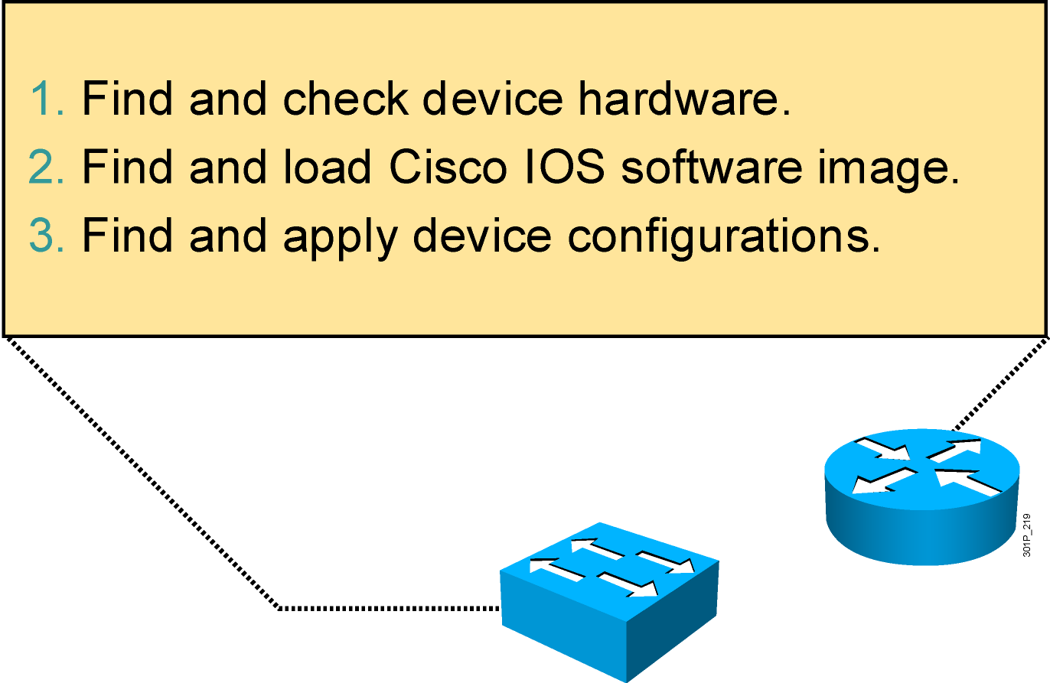
An Overview of Cisco Device Startup
Notes:
Purpose: This slide introduces the startup process on Cisco routers and switches.
Emphasize: Paraphrase or restate the three points and make sure your students follow the description. This description is necessary to keep a common perspective of what is occurring on the switch and the router; these three steps should be an anchor to return to as needed.
Transition: Where are the sources for configuration software?

Slide 6
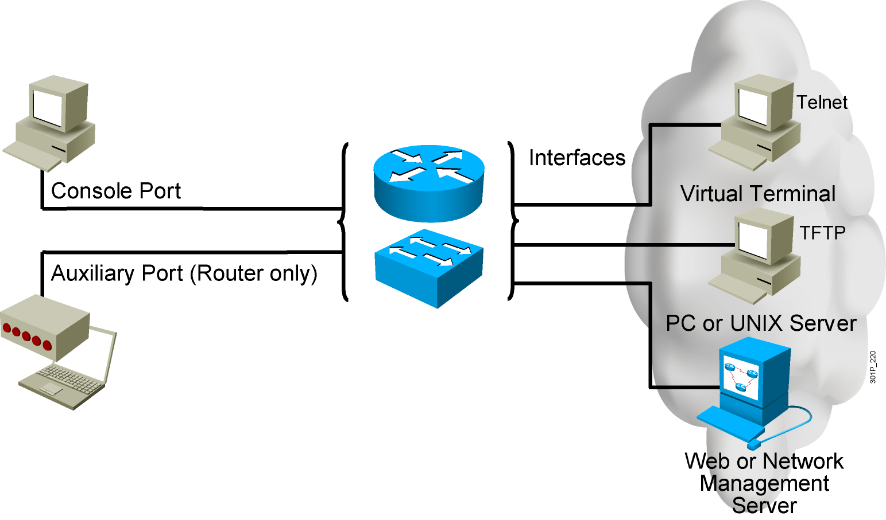
External Configuration Sources
Configurations can come from many sources.
Configurations will act in device memory.
Notes:
Purpose: This slide describes the different ways students can access the Catalyst switch or Cisco router to create a new configuration file or alter an existing one.
Emphasize: The network device can be configured from several locations. After you create the initial configuration, you can configure the ports or interfaces to enable configuration over virtual terminal ports (vty).
Both the router and switch support Telnet access as a virtual terminal.
The router by default supports virtual terminals 0 through 4. The router can be accessed for configuration purposes from the console port, the auxiliary port, and five VTY lines at the same time—up to seven people can configure the router at once.
You should caution students about the above point and inform them that security should be strictly observed through password protection to avoid unauthorized access of the configuration files.
Another component important to configuration in the network is a TFTP server.
The TFTP server can be a UNIX or PC workstation that acts as a central depository for files.
You can keep configuration files on the TFTP server and then download them to the device.
You can also configure them from a network management station running network management software such as CWSI, CiscoWorks, or HP OpenView. Before you can access or change the configuration from a virtual terminal, TFTP server, or network management station, you must have the device configured to support IP traffic.

Slide 7
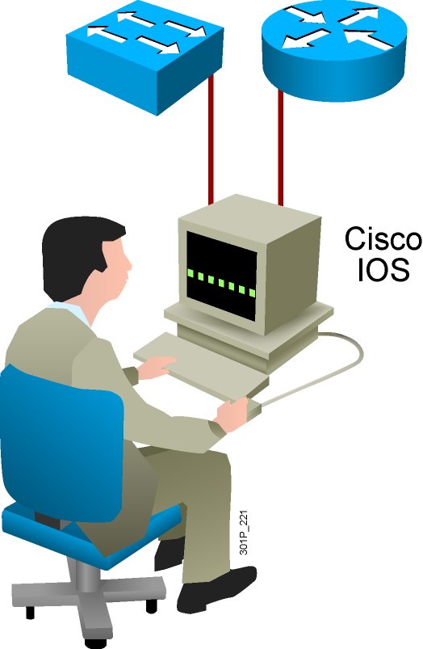
Cisco IOS User Interface Functions
CLI is used to enter commands.
Operations vary on different internetworking devices.
Users type or paste entries in the console command modes.
Command modes have distinctive prompts.
Enter key instructs device to parse and execute the command.
Two primary EXEC modes are user mode and privileged mode.
Notes:
Purpose: This slide introduces the two Cisco IOS EXEC modes on the Catalyst 1900 switch and routers.
Emphasize: As you present this, describe the bullet points that can prepare your students to work with the Cisco IOS user interface.

Slide 8
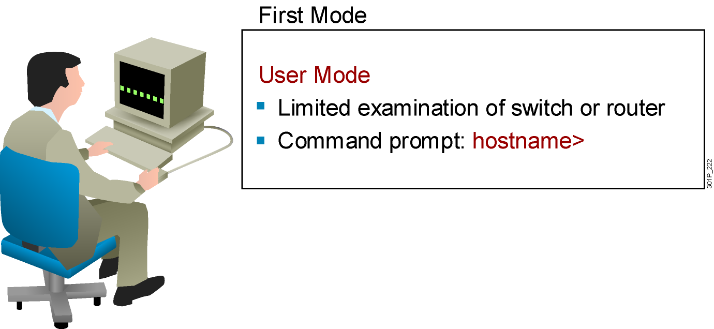
Cisco IOS Software EXEC Mode (User)
There are two main EXEC modes for entering commands.
Notes:
Slide 1 of 2
Purpose: This slide describes the user EXEC mode.
Emphasize: Present the operational aspects of user EXEC mode.
Tell your students that this command level allows them to access only a limited amount of basic monitoring commands.
Emphasize that they need to look carefully at the command prompter to make sure that they are in the appropriate mode for the command that they want to enter into the network device. If your class can remember this, this will eliminate (or at least reduce) the number of times that you have to point out that a lab step is failing because the student is in user mode rather than in enabled mode.
Transition: An introduction of privileged (or enabled) mode.

Slide 9
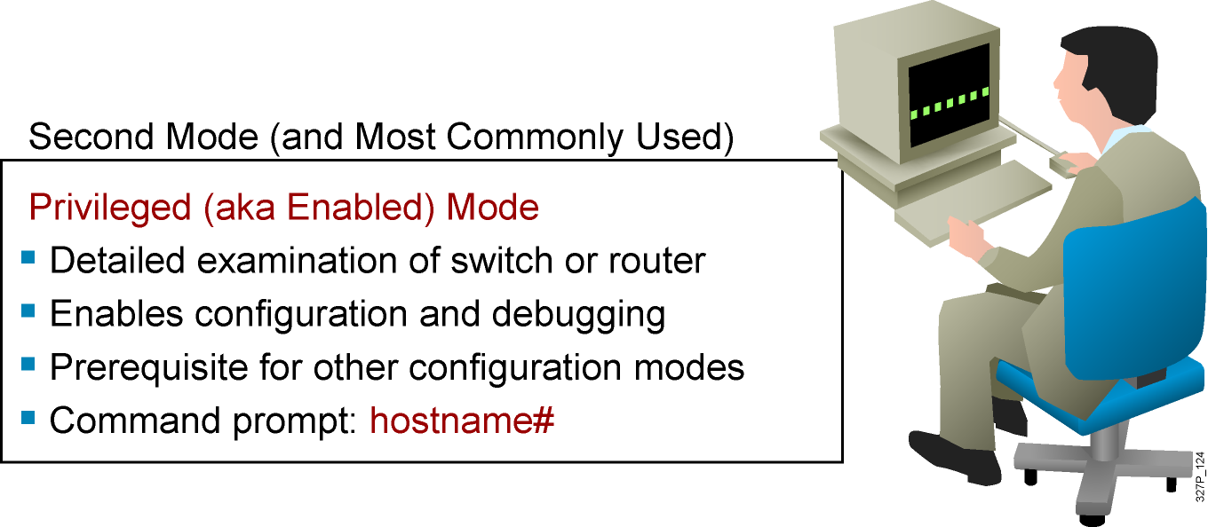
Cisco IOS Software EXEC Mode (Privileged)
Notes:
Slide 2 of 2
Purpose: This slide describes the privileged EXEC mode.
Emphasize: As you present the introductory material on privileged (also called “enabled”) mode, emphasize that this mode is the entry mode for all other configuration modes. Tell your students that they will need this mode for ICND labs and most of the network administration that they do back on the job.
Use the analogy of “the price of admission.” You must enter enable followed by the correct enable password; otherwise, you will not get into the network device; and will have to stay outside in user mode where you can only see a few basic things about the network device.
Note: This slide ends the introductory material that is common to the network devices covered in ICND.
Transition: Material specific to the initial startup of the Catalyst switch.

Slide 10
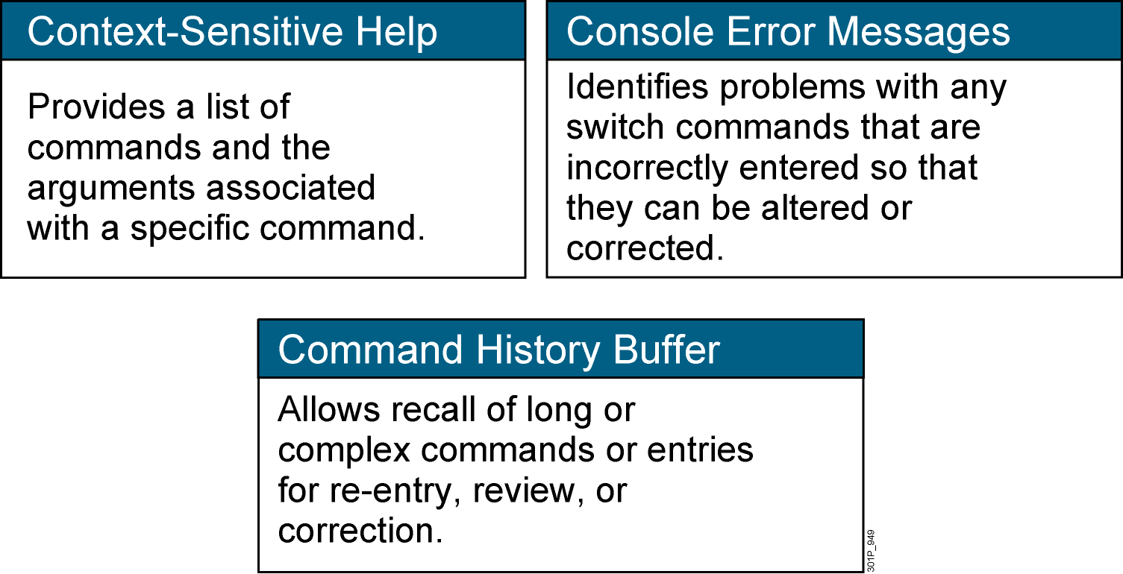
Switch Command-Line Help Facilities
Notes:
Purpose: This slide describes the Help facilities on the Catalyst 1900 switch.
Emphasize: After showing how to log in to the Catalyst 1900 Cisco IOS CLI and enabled EXEC privileged mode, use this slide to present the three main types of command-line help available.
This list is similar to, but not as extensive as the types of command-line help on the router that you present later with a similar slide.
If at this point you can demonstrate what you are presenting, so much the better.
The help on the switch is very similar to the help on the router, so the details are only presented once, in the router section.

Slide 11
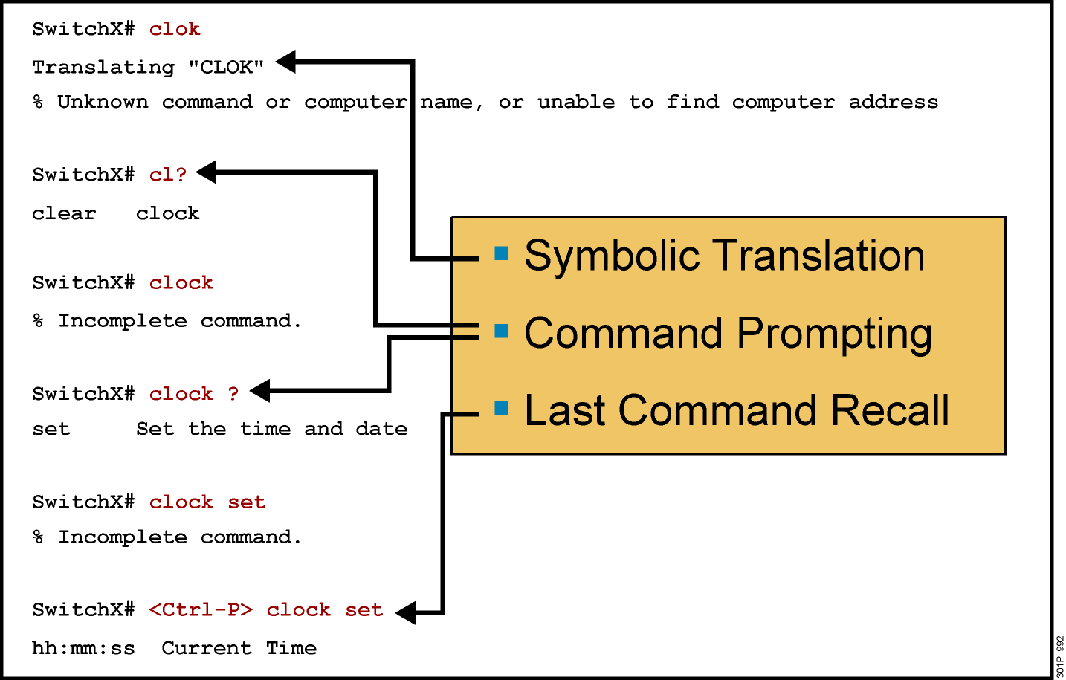
Context-Sensitive Help
Notes:
Slide 1 of 2
Emphasize: Suppose you want to set the router clock. If you do not know the command, use context-sensitive help to check the syntax for setting the clock. The help output shows that the set keyword is required. Next, check the syntax for entering the time.
Now enter the current time using hours, minutes, and seconds, as shown.
The system indicates that you need to provide additional arguments to complete the command. Press Ctrl-P (or Up arrow) to repeat the previous command entry automatically. Then add a space and a question mark (?) to reveal the additional arguments.
Now you can complete the command entry.
The caret symbol (^) and help response indicate an error. To list the correct syntax, reenter the command up to the point where the error occurred, and then enter a question mark (?).
Enter the year using the correct syntax and press Return to execute the command.
Note that the user interface provides syntax checking in the form of an error location indicator (^). The caret symbol character appears at the point in the command string where you entered an incorrect command, keyword, or argument. The error location indicator and interactive help system allow you to find and correct syntax errors easily.

Slide 12
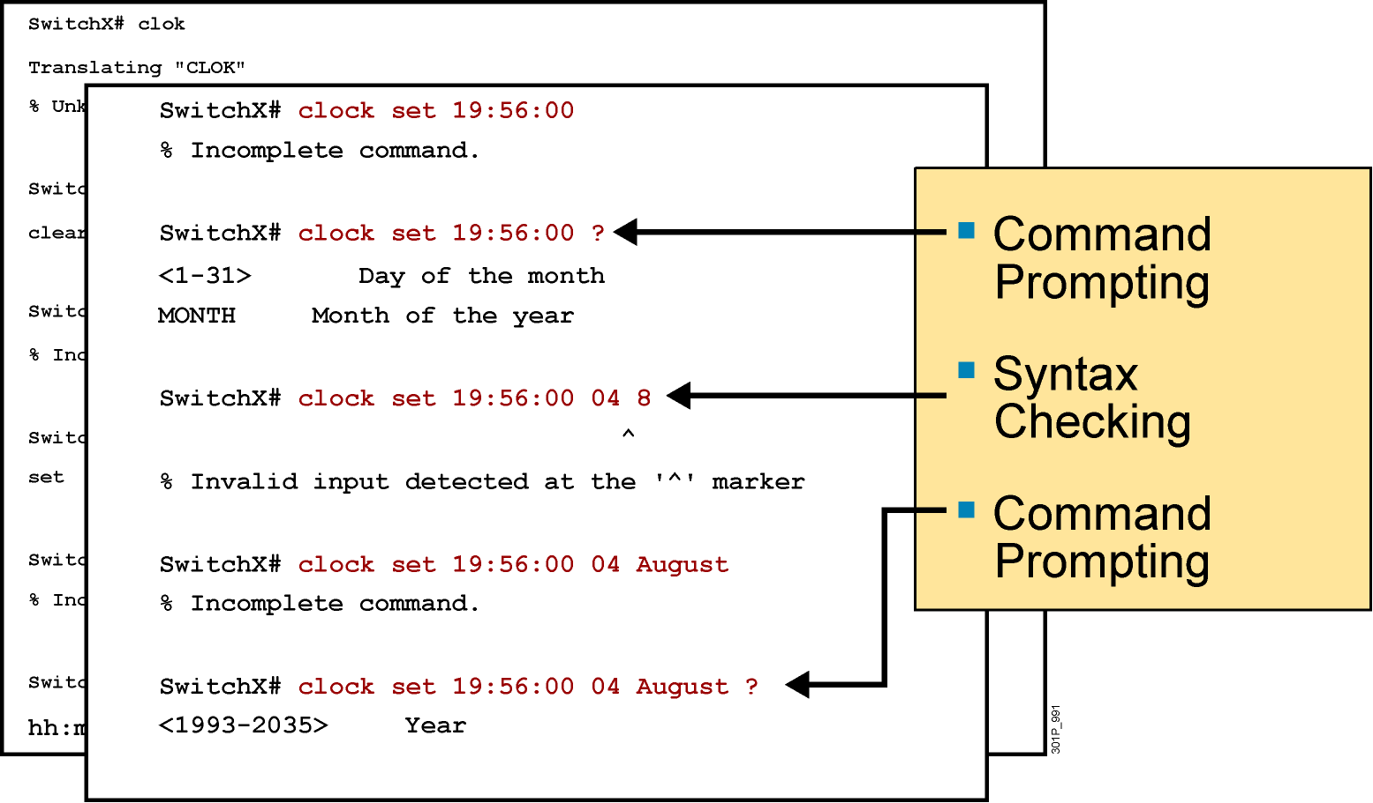
Context-Sensitive Help (Cont.)
Notes:
Slide 2 of 2

Slide 13
Enhanced Editing Commands
SwitchX>Shape the future of internetworking by creating unpreced
Shape the future of internetworking by creating unprecedented value for customers, employees, and partners.
Notes:
Layer 1 of 9
Purpose: This slide explains how to use the editing capabilities of Cisco IOS software.
Emphasize: Layer 1—Some commands can be longer than the number of characters available on the screen after the prompt. The user interface now supports automatic scrolling of long lines. Notice that we have run out of room on this line. The line will scroll over ten spaces at a time in order to allow longer lines.

Slide 14
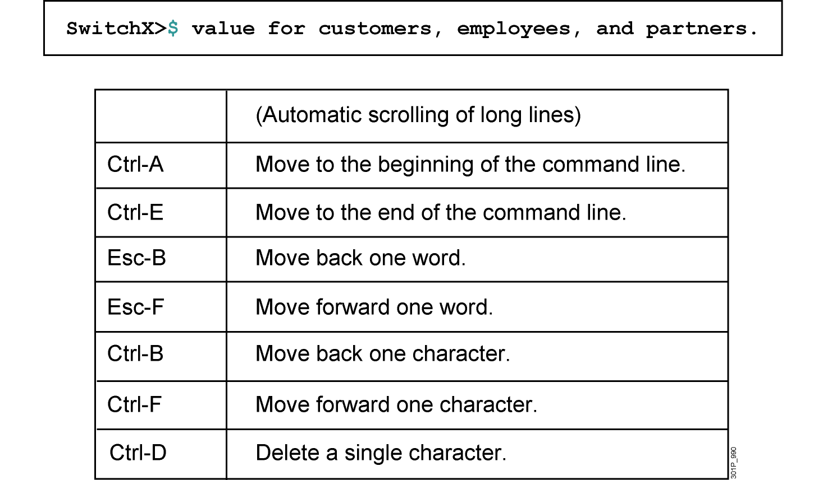
Enhanced Editing Commands (Cont.)
Notes:
Layer 9 of 9
Emphasize: Layer 9 — Ctrl-D deletes a single character.

Slide 15
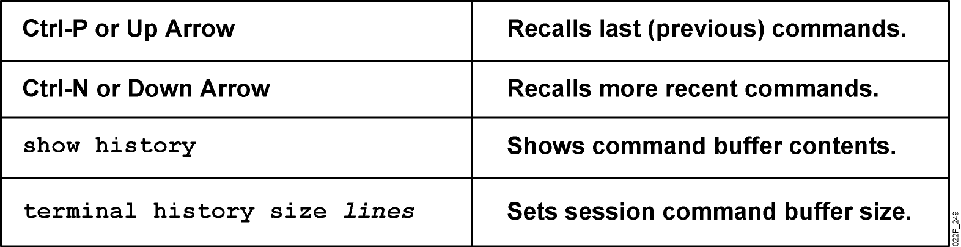
Router Command History
Notes:
Emphasize: The user interface provides a history or record of commands you have entered. This feature is particularly useful for recalling long or complex commands or entries. With the command history feature, you can complete the following tasks:
Set the command history buffer size
Recall commands
Disable the command history feature
By default, command history is enabled and the system records ten command lines in its history buffer. To change the number of command lines the system will record during the current terminal session, use the terminal history size or history size command. The maximum number of commands is 256.
To recall commands in the history buffer beginning with the most recent command, press Ctrl-P or the Up arrow key. Repeat the key sequence to recall successively older commands.To return to more recent commands in the history buffer after recalling commands with Ctrl-P or the Up arrow, press Ctrl-N or the Down arrow. Repeat the key sequence to recall successively more recent commands.
Once you enter the unique characters for a command, press the Tab key and the interface will finish the entry for you.
On most laptop computers you may also have additional select and copy facilities available. Copy a previous command string, then paste or insert it as your current string.
Note: The Catalyst 1900 has a fixed history size of ten which can’t be changed.

Slide 16
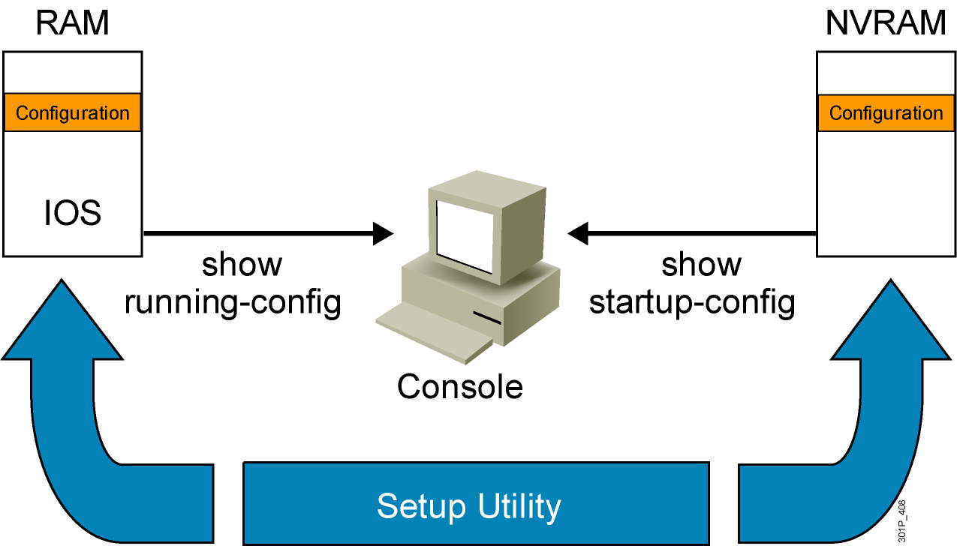
Viewing the Configuration
Notes:
Emphasize: When you exit the setup mode, the configuration can be saved to RAM and NVRAM at the same time.
Note: The Catalyst 1900 has no show start command. It automatically saves the running configuration to NVRAM.

Slide 17
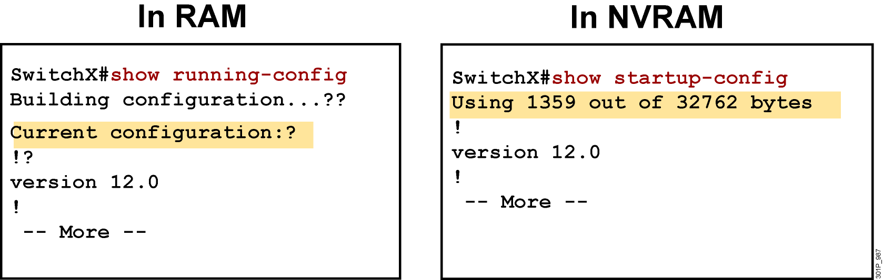
show running-config and show startup-config Commands
Displays the current and saved configuration
Notes:
Purpose: This slide shows the format and output of the show running-config and show startup-config commands, which display the active and backup configuration files, respectively.
Emphasize: We put these two commands on the same page because it is easy to confuse the two. The show running-config command displays the configuration information in memory, while the show startup-config command displays the backup file.
Often in class someone will enter commands and then say that the router did not accept them. This scenario might indicate that the person entered the commands to modify the configuration information in memory, and then entered a show startup-config (show config) to look at the backup file that has not yet been updated to reflect the changes. You must use another command to update the backup file.
Default parameters do not display in the running configuration.
In Cisco IOS Release 10.2 and earlier, the write terminal command shows the running configuration, and the show config command shows the startup configuration.

Slide 18
LAN Connections
Using the Cisco SDM

Slide 19
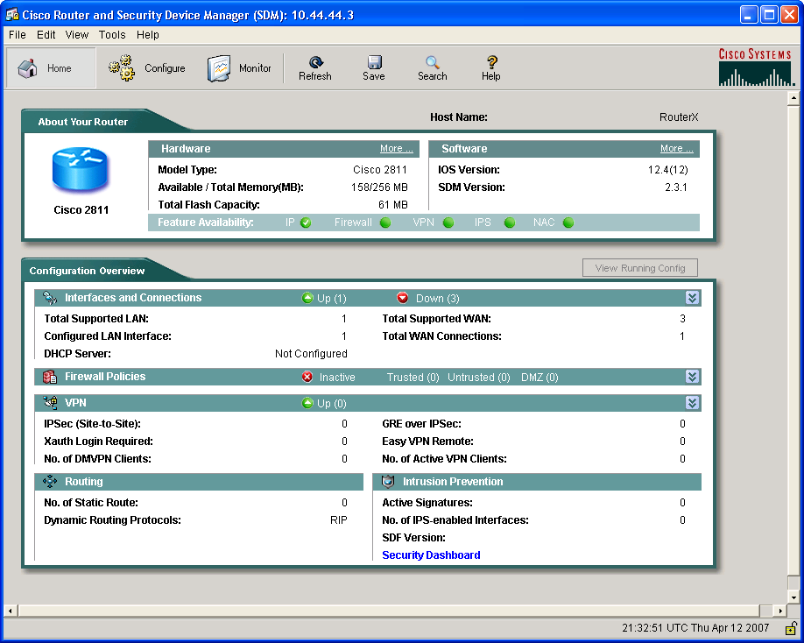
Cisco Router and Security Device Manager

Slide 21
What Is Cisco SDM?
Embedded web-based management tool
Provides intelligent wizards to enable quicker and easier deployments and does not require knowledge of Cisco IOS CLI or security expertise
Tools for more advanced users:
ACL editor
VPN crypto map editor
Cisco IOS CLI preview
Notes:
What is Security Device Manager (SDM)?
SDM is an easy-to-use Internet browser-based device management tool that is embedded within the Cisco IOS 800 – 3700 Series access routers at no cost.
It simplifies router and security configuration through the use of intelligent wizards to enable customers and partners to quickly and easily deploy, configure and monitor a Cisco access router.
SDM is designed for resellers and network administrators of small- to medium-sized businesses who are proficient in LAN fundamentals and basic network design, but has little or no experience with IOS command-line interface (CLI) or may not be a security expert.
SDM is also great for Advanced users too. It has a number of time saving tools. Examples include ACL editor, VPN crypto map editor, IOS CLI preview, and many more.

Slide 22
Supported Cisco Routers and Cisco IOS Software Releases
Cisco SDM is supported on a number of Cisco router platforms and Cisco IOS Software releases.
Always verify Cisco SDM router and Cisco IOS release support at www.cisco.com/go/sdm.

Slide 23
Configuring Your Router to Support SDM
Enable the HTTP and HTTPS servers on your router.
Create a user account defined with privilege level 15 (enable privileges).
Configure SSH and Telnet for local login and privilege level 15.

Slide 24
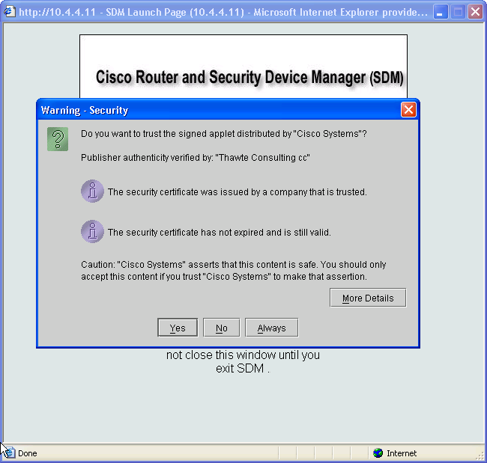
SDM Startup

Slide 26
Cisco SDM Main Window Layout and Navigation
Menu Bar
Toolbar
Router
Information
Configuration
Overview
Notes:
When SDM is launched, SDM reads the existing router configuration. You will see a message stating this.
Then it will present the features that it supports as available for configuration through the SDM.
At the top of the screen you will see the typical menu bar with File, view, edit, tools and help.
Below that is the SDM tool bar. It has the SDM wizards and modes you can select.
On the left side under the tool bar displays the current mode you are in.
The menu, tool bar, and current mode are always displayed at the top of each screen. The other parts of the screen change based upon the mode and function you are performing.
The far left panel is the Category Bar. It changes with the options available based on the mode you are in.
When you log in, the first page displayed is the Overview page. It gives you a great summary of the router.
It displays the router model, total amount of memory and flash, IOS and SDM versions, the hardware installed and a summary of some security features such as firewall status and the number of active VPN connections.

Slide 27
Menu Bar
Toolbar
Router
Information
Configuration
Overview

Slide 28
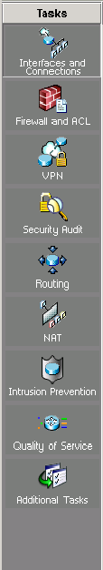
Cisco SDM Wizards
LAN configuration: Configure LAN interfaces and DHCP
WAN configuration: Configure PPP, Frame Relay, and HDLC WAN interfaces
Firewall
VPN
Security audit: Perform a router security audit, with a button for router lockdown
IPS: Intrusion prevention system
QoS: Quality of service
Notes:
Click Wizard to enter this mode.
If there’s delta configuration within SDM and you attempt to enter the wizard mode a dialog box appears. It states that you must perform a Refresh or Deliver before entering the Wizard Mode. Click either button to perform one of those functions.
When the page appears the wizards are displayed on the left.
I have already describe the Overview page. It is not a wizard, but you can click on some features and it may open a wizard.
LAN wizard is used to configure the LAN interfaces and DHCP.
WAN wizard is used to configure PPP, Frame Relay, HDLC WAN interfaces
Firewall provides two wizards. A simple inside/outside wizard or more complex inside/outside/DMZ with multiple interfaces.
For VPN, there are three wizards. A secure site-to-site VPN, Easy VPN and GRE tunnel with IPSec.
Security Audit contains two wizards. The router security audit and an easy one-step router security lock down wizard.
The last wizard resets the router configuration back to the SDM factory default configuration settings.
While in the Wizard modes, all changes are automatically delivered using generated CLI commands upon finishing the wizard.
A user can choose whether or not to preview the commands sent. The default is “No Preview” which can be altered in the Preferences menu.

Slide 29
LAN configuration: Configure LAN interfaces and DHCP
WAN configuration: Configure PPP, Frame Relay, and HDLC WAN interfaces
Firewall
VPN
Security audit: Perform a router security audit, with a button for router lockdown
IPS: Intrusion prevention system
QoS: Quality of service

Slide 30
Network Environment Management
Managing Cisco Devices

Slide 31
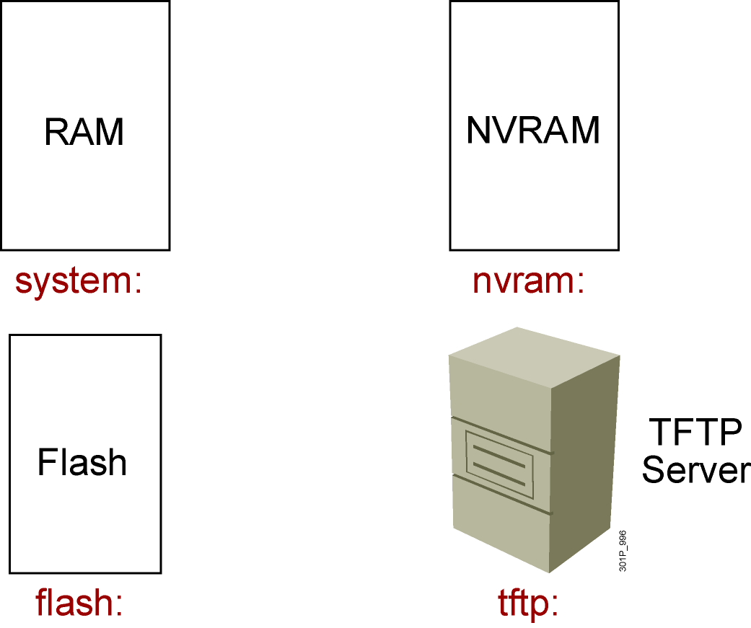
Cisco IOS File System and Devices
Notes:
Emphasize: In Cisco IOS Release 12.0, there are new copy commands. These new commands treat the RAM, Flash, NVRAM, TFTP, FTP, and so on as a file system. Since this class was developed when the most common Cisco IOS in the field is pre-12.0, these 12.0 commands are not covered in detail in this class.

Slide 32
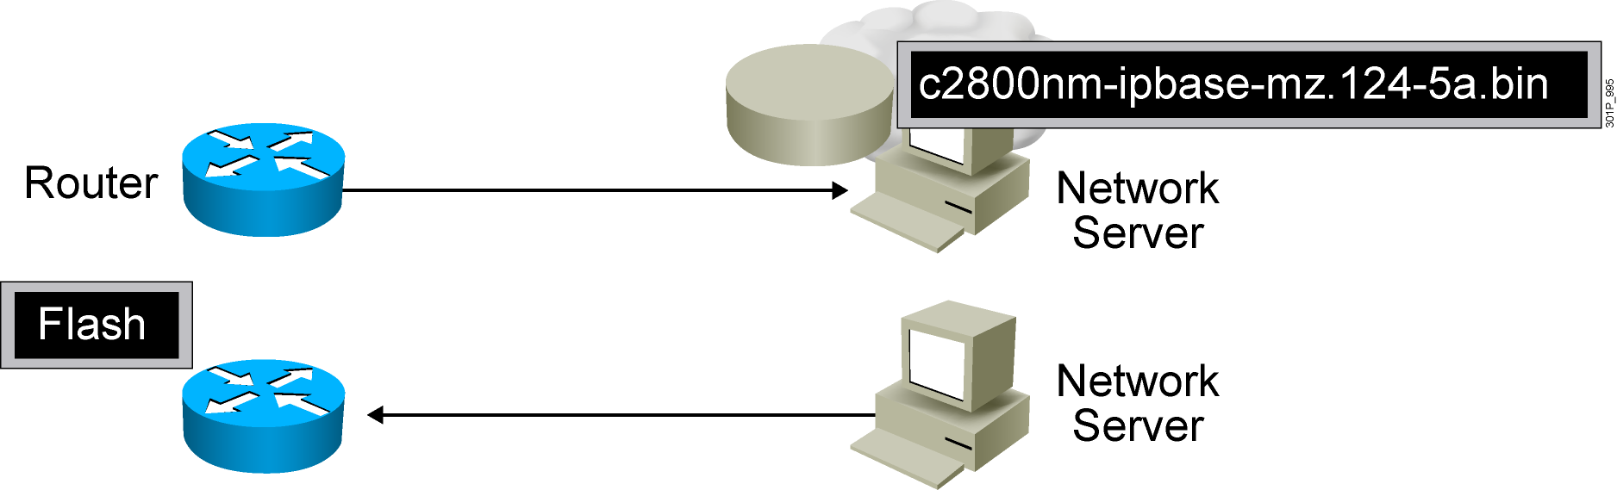
Managing Cisco IOS Images
Notes:
Emphasize: This section introduces topics on managing your configuration file and Cisco IOS image.

Slide 33
Verifying Memory and Deciphering Image Filenames
RouterX#sh flash
-#- --length-- -----date/time------ path
1 14951648 Feb 22 2007 21:38:56 +00:00 c2800nm-ipbase-mz.124-5a.bin
2 1823 Dec 14 2006 08:24:54 +00:00 sdmconfig-2811.cfg
3 4734464 Dec 14 2006 08:25:24 +00:00 sdm.tar
4 833024 Dec 14 2006 08:25:38 +00:00 es.tar
5 1052160 Dec 14 2006 08:25:54 +00:00 common.tar
6 1038 Dec 14 2006 08:26:08 +00:00 home.shtml
7 102400 Dec 14 2006 08:26:22 +00:00 home.tar
8 491213 Dec 14 2006 08:26:40 +00:00 128MB.sdf
41836544 bytes available (22179840 bytes used)
Verify that flash memory has room for the Cisco IOS image.
Notes:
Emphasize: The show flash command is an important tool to use to gather information about your router memory and image file. Caution students that they must know that they are loading the correct and appropriate image. The name for the Cisco IOS image file contains multiple parts, each with a specific meaning:
The first part of the image name contains the platform on which the image runs. In this example, the platform is C2500.
The second part of the name identifies the special capabilities of the image file. A letter or series of letters identifies the feature sets supported in that image. In this example, the “j” indicates this is an enterprise image, and the “s” indicates it contains extended capabilities.
The third part of the name specifies where the image runs and if the file is compressed. In this example, “l” indicates the file is relocatable and not compressed. Relocatable means the Cisco IOS can be run from Flash or from RAM. You should be careful in reading the Cisco IOS image filename. Some fonts display the lowercase letter “l” and the number 1 as the same character. How you enter the characters will impact the ability of the router to load the files correctly.
The fourth part of the name indicates the version number. In this example, the version number is 12.0 (3).
The final part of the name is the file extension. The .bin extension indicates this file is a binary executable file.
The Cisco IOS software naming conventions, name part field meaning, image content, and other details are subject to change. Refer to Cisco Connection Online (CCO) for updated details.

Slide 34

Creating a Software Image Backup
RouterX#copy flash tftp:
Source filename []? c2800nm-ipbase-mz.124-5a.binAddress or name of remote host []? 10.1.1.1
Destination filename [c2800nm-ipbase-mz.124-5a.bin]
!!!!!!!!!!!!!!!!!!!!!!!!!!!!!!!!!!!!!!!!!!!!!!!!!!!!!!!!!!!!!<output omitted>
12094416 bytes copied in 98.858 secs (122341 bytes/sec)
RouterX#
Back up current files prior to updating flash memory.
Notes:
Purpose: This slide discusses how to create a backup version of a Cisco IOS software image to a TFTP server.
Emphasize: Routers by default come with Flash memory that has a preloaded copy of the Cisco IOS software. Although Flash is extremely reliable—good for 65 years and 100,000 rewrites—it is a good idea to make a backup copy of the Cisco IOS software if you have a TFTP server available. If you have to replace Flash memory for some reason, you will have a backup copy at the revision level currently running on your network.
The copy command screen output varies depending on the Cisco IOS software level.
Determine the platform type of your TFTP server prior to beginning the backup procedure. The TFTP server may be running Windows, UNIX, Mac, or other OS. Filename and directory access procedures may vary depending on the TFTP server platform and platform version.

Slide 35

Upgrading the Image from the Network
RouterX#copy tftp flash:
Address or name of remote host [10.1.1.1]?
Source filename []? c2800nm-ipbase-mz.124-5a.bin
Destination filename [c2800nm-ipbase-mz.124-5a.bin]
Accessing tftp://10.1.1.1/c2600-js-mz.122-21a.bin...
Erase flash: before copying? [confirm]
Erasing the flash filesystem will remove all files! Continue? [confirm]
Erasing device... eeeeeeeeee (output omitted) ...erased
Erase of flash: complete
Loading c2800nm-ipbase-mz.124-5a.bin from 10.1.1.1 (via Ethernet0/0): !!!!!!!!!!!!!!!
(output omited)
[OK - 12094416 bytes]
Verifying checksum... OK (0x45E2)
12094416 bytes copied in 120.465 secs (100398 bytes/sec)
RouterX
Notes:
Purpose: This slide describes how to load a backup version of a Cisco IOS software image from a TFTP server to the router.
Emphasize: If you need more Flash space to load a copy of the Cisco IOS software, you must first erase the Flash memory. You cannot erase a single image—you must erase all copies of Cisco IOS software from Flash. However, if Flash memory on the router is partitioned, you can erase one or more of the parts.
After the TFTP transfer is completed, use the show flash command to view the file size to compare its size with that of the original on the server.
If the Cisco IOS is running from Flash, then the Flash is in the read-only state. To change the Flash to a writeable state, you can use the boot system TFTP command to boot a Cisco IOS from a TFTP server and the Cisco IOS will be run from RAM, or you can go to the Rxboot mode to perform the copy.

Slide 36
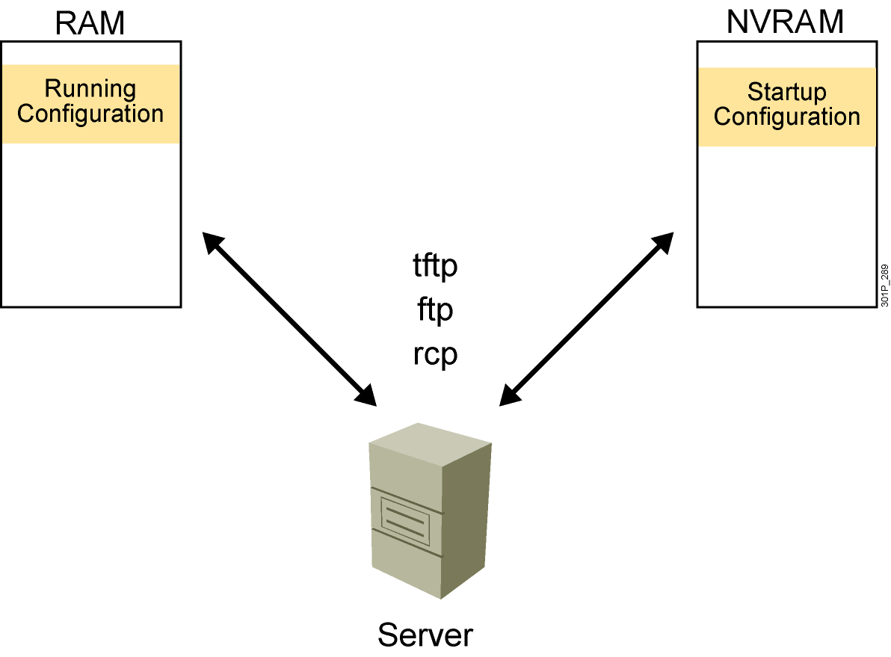
Device Configuration Files

Slide 37
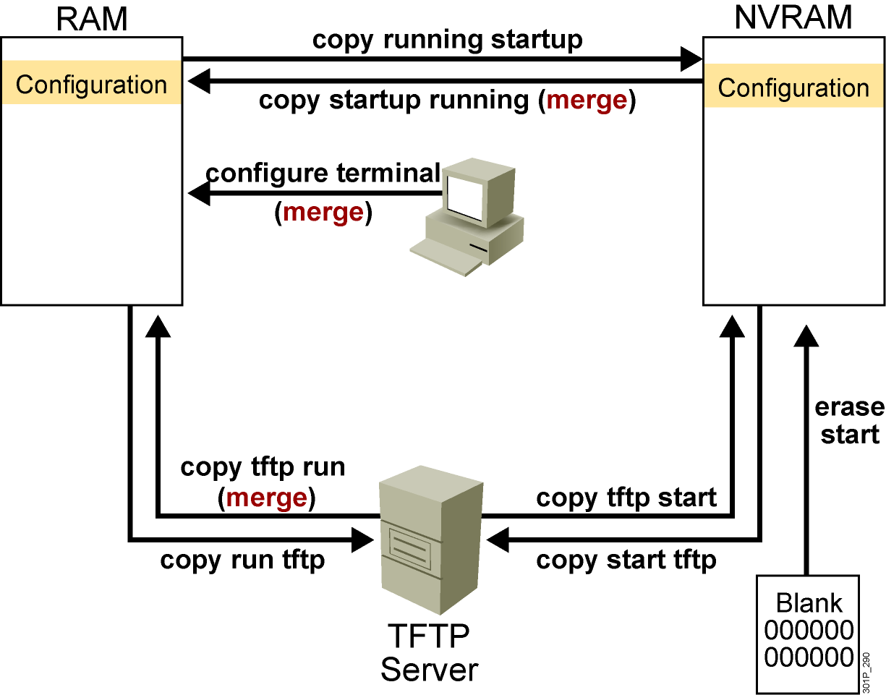
Cisco IOS copy Command
NVRAM
Terminal
TFTP server
Erase start
Notes:
Layer 4 of 4

Slide 38
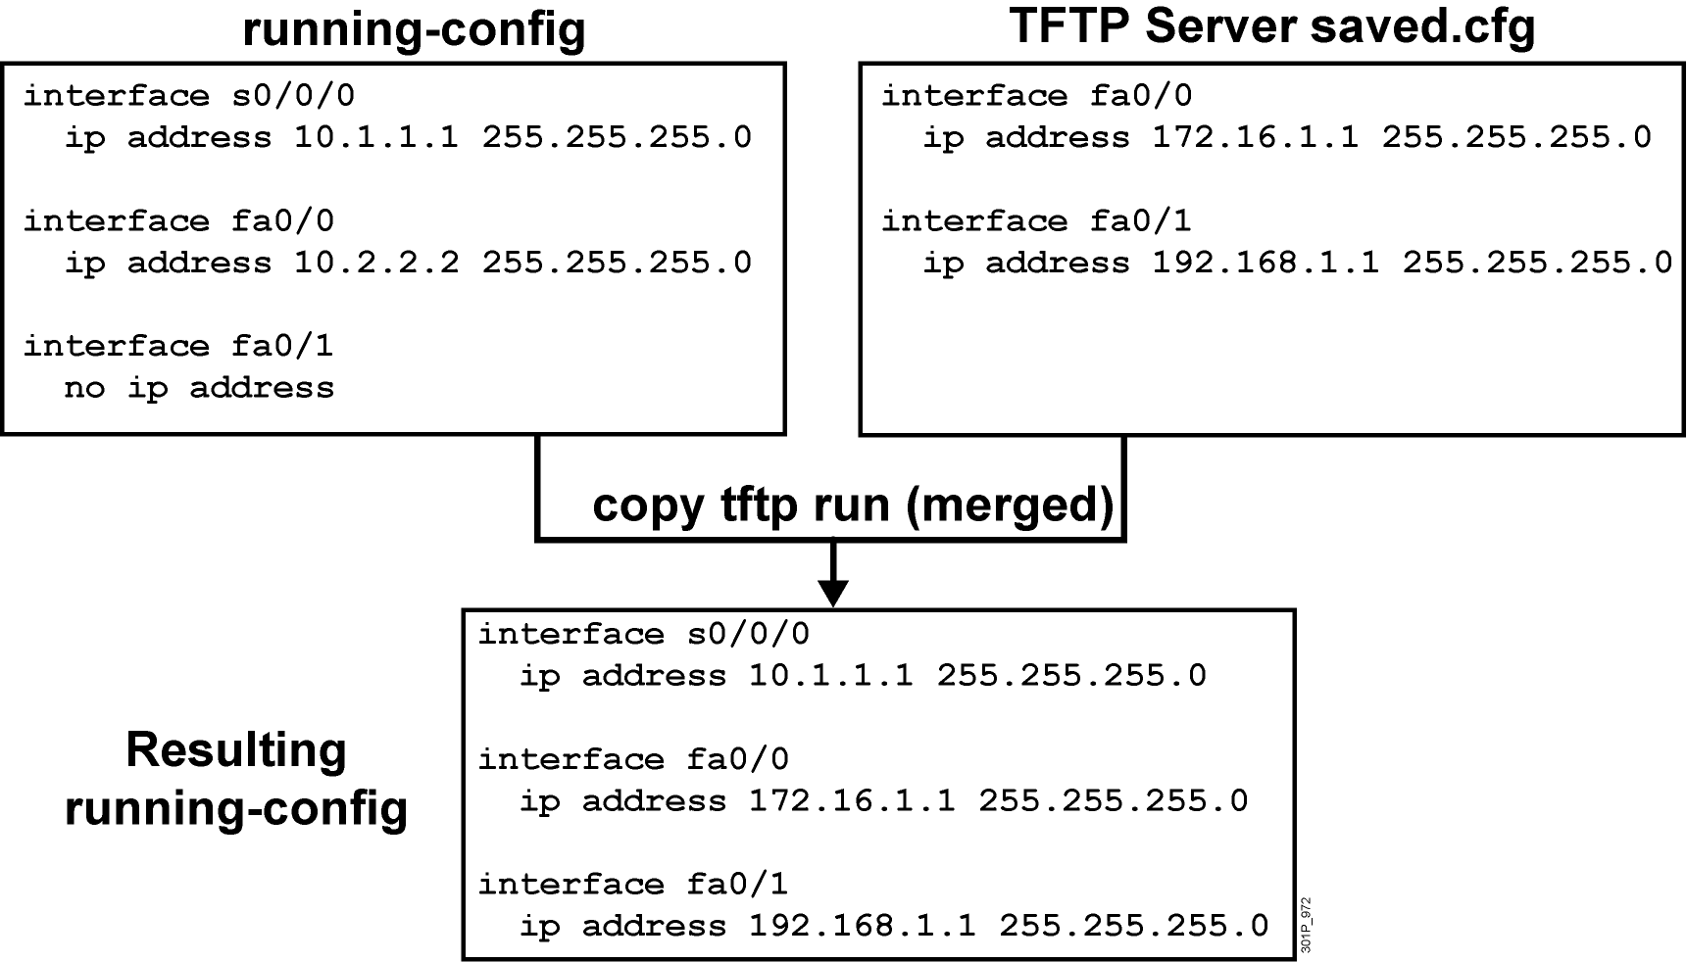
Cisco IOS copy Command Example
Notes:
Note: Cisco IOS Release 12.0 supports a new syntax for the copy command.

Slide 39
copy run tftp and copy tftp run Commands
RouterX#copy running-config: tftp:
Address or name of remote host []? 10.1.1.1
Destination filename [running-config]? wgroa.cfg
.!!
1684 bytes copied in 13.300 secs (129 bytes/sec)
RouterX#copy tftp: running-config:
Address or name of remote host []? 10.1.1.1
Source filename []? wgroa.cfg
Destination filename [running-config]?
Accessing tftp://10.1.1.1/wgroa.cfg...
Loading wgroa.cfg from 10.1.1.1 (via Ethernet0): !
[OK - 1684/3072 bytes]
1684 bytes copied in 17.692 secs (99 bytes/sec)
Notes:
Note: Cisco IOS Release 12.0 supports a new syntax for the copy command.

Slide 40
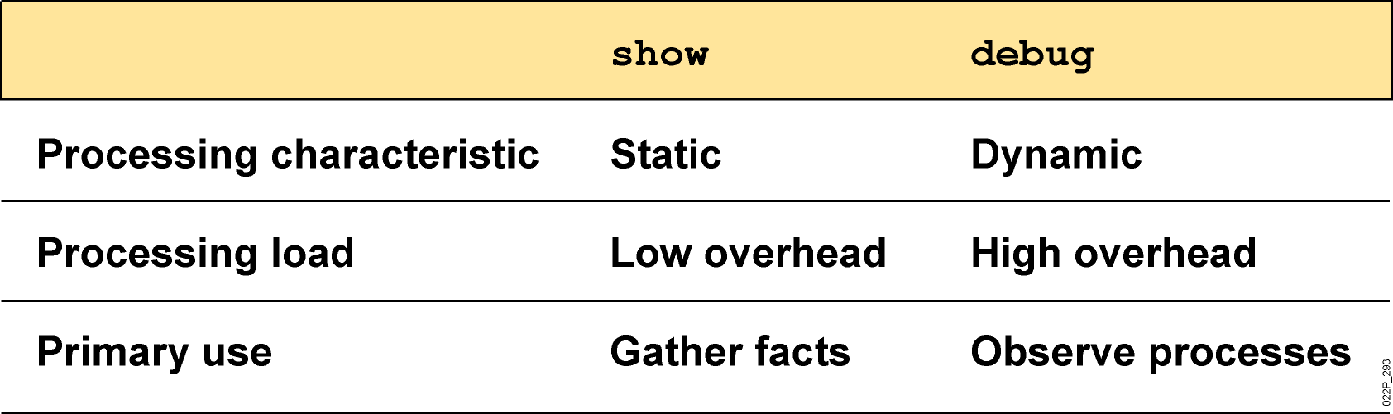
show and debug Commands

Slide 41
Considerations When Using debug Commands
May generate output in a variety of formats that may not identify the problem
Require high overhead, possibly disrupting network device operation
Useful for obtaining information about network traffic and router status

Slide 42
Commands Related to debug
RouteX(config)#
service timestamps debug datetime msec
Adds a time stamp to a debug or log message
RouteX#
show processes
Displays the CPU utilization for each process
RouteX#
no debug all
Disables all debug commands
RouteX#
terminal monitor
Displays debug output on your current vty session

Slide 43
Summary
Cisco IOS software is the embedded software architecture in all Cisco IOS devices and is also the operating system of Catalyst switches. Its functions include carrying the chosen network protocols, connectivity, security, scalability, and reliability.
A switch or IOS device can be configured from a local terminal connected to the console port or from a remote terminal connected via a modem connection to the auxiliary port.
The CLI is used by network administrators to monitor and configure various Cisco IOS devices. CLI also offers a help facility to aid network administrators with the verification and configuration commands.

Slide 44
Summary (Cont.)
The CLI supports two EXEC modes: user and privileged. The privileged EXEC mode provides more functionality than the user EXEC mode.
The Cisco IOS devices uses Cisco IOS software with extensive command-line input help facilities, including context-sensitive help.
The Cisco IOS CLI includes an enhanced editing mode that provides a set of editing key functions.
The Cisco IOS devices CLI provides a history or record of commands that have been entered. This feature, called the command history, is particularly useful to help recall long or complex commands or entries.

